Slide 1
MBA532 – AI in Business
MODULE 7 – Generative AI and Explainable AI

Slide 2
Progress, Growth and Benefits of Generative AI
Progress, Growth, and Benefits of Generative AI

Slide 3
Assessing Progress in Generative AI
In the field of Generative AI, the focus is on the following two contentions of AI firms: * One, AI industry should not be accused of stealing content that was scraped from openly accessible sources on the Internet; * Two, AI companies should not be held liable for outcomes from the use of Generative AI applications.
It is clear now that many authors and publishers of written content (copyrighted or not) disagree on the first premise above; on the second notion, legal experts agree that the Section 230 of the Communications Decency Act of 1996 does not extend the same protections to AI companies that is available to Internet platforms like Facebook, X etc.
Given the explosive growth, adoption and positive benefits that Generative AI has yielded thus far, it is likely that AI firms (and the tech and other industries that eagerly embraced Generative AI) will lobby heavily for new legislation that offers protections equivalent to Section 230 above, while courts will determine what the appropriate compensation of authors/publishers should be based on the extent of Generative AI’s use of their content.

Slide 4
Case Study: Benefits from Generative AI
Given the potential of generative AI to improve productivity in many other functions—indeed, any that involve cognitive tasks—calling it revolutionary is no hyperbole. Business leaders should view it as a general-purpose technology akin to electricity, the steam engine, and the internet.
Cresta – a generative AI startup – faced a challenge in training and retaining customer service agents. A LLM was introduced to listen-in on customer conversations with service agents. It monitored the online chats for specific phrases, and when one occurred, it based its responses on the information in the in-context learning system. As a safeguard, the LLM did not respond to customers directly, but presented its response to customer service agents who could consider it, and feel free to apply common sense to decide whether or not to accept the LLM response.
Results: Both the average number of issues resolved per hour and the number of chats an agent could handle simultaneously increased by almost 15%; the average chat time decreased by nearly 10%; and an analysis of the chat logs showed that immediately after the new system was implemented, customer satisfaction improved. (Source: How to Capitalize on Generative AI, Harvard Business Review, December 2023).

Slide 5
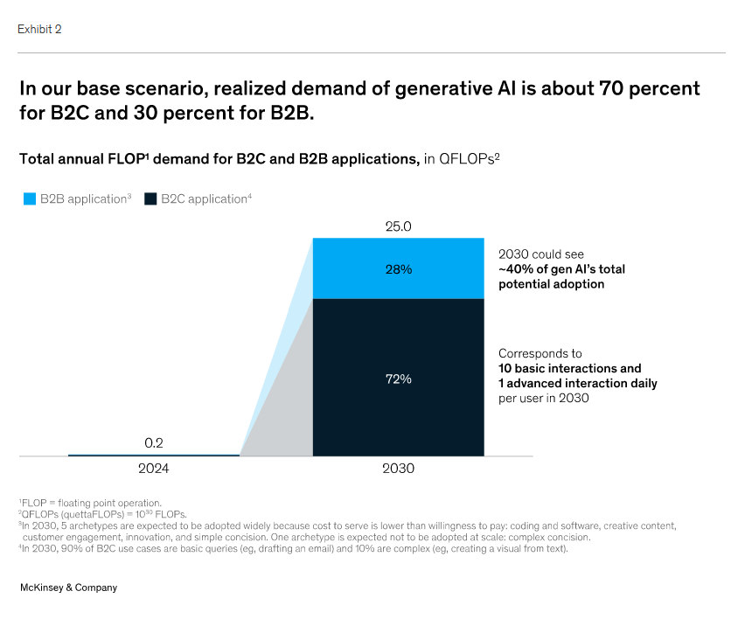
Generative AI Market Growth Forecast
As generative AI (gen AI) applications such as ChatGPT take the world by storm in both B2B and B2C domains, businesses are figuring out how to leverage this.
Source of exhibit on left:
(Generative AI: The next S-Curve)
The scale of McKinsey’s forecasted growth In demand for compute power for Generative AI applications by 2030 is explosive/impressive,
when compared to 2024.

